Slide 1
Agrobacterium slides
Feel free to use any of my slides/pictures. Some material (6b, biovar, and tables are from other papers, would recommend finding proper source if you use)
Throw a reference to me if you use anything, Timothy M Chappell, University of Georgia.
There is a geneious ‘Ti plasmid’ map just roughly done with 1000 bp. I was tired of the generic Ti plasmid most people use, and doesn’t allow the option of changing specifics within operons, multiple borders, etc. Upload into your geneious program, change anything you want, export image as a static PDF, or as EMF if you want to use powerpoint objects (will test your patience).
Any galling pictures are from me and were done on different soybean genotypes with A281.
Homologous recombination is shown with EF-Tu (tufA/tufB) in Agrobacterium C58 (has 2 identical copies), but feel free to change and replace. All homogolous recombination work I have done/shown is based on Brian Kvitko’s (University of Georgia) work.
Sorry if there are any errors

Slide 2
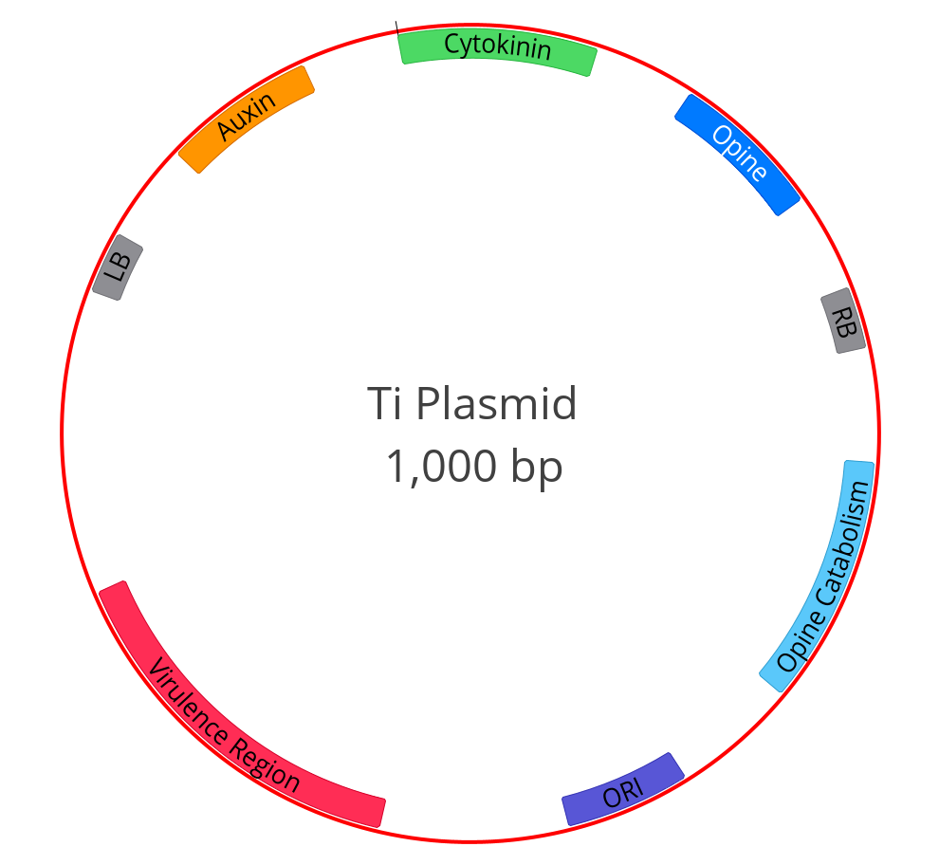
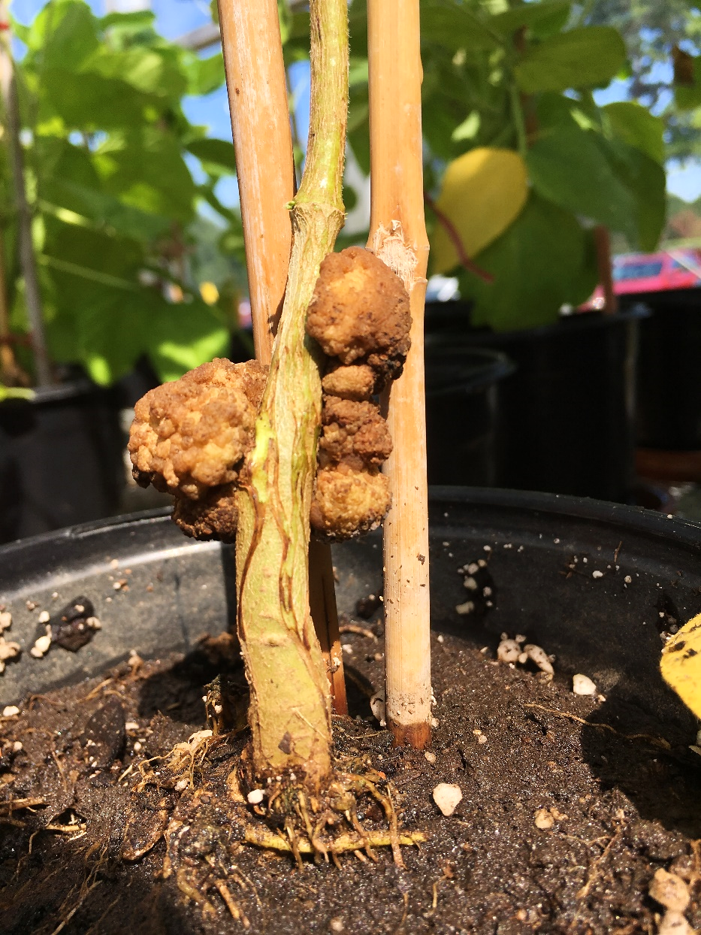
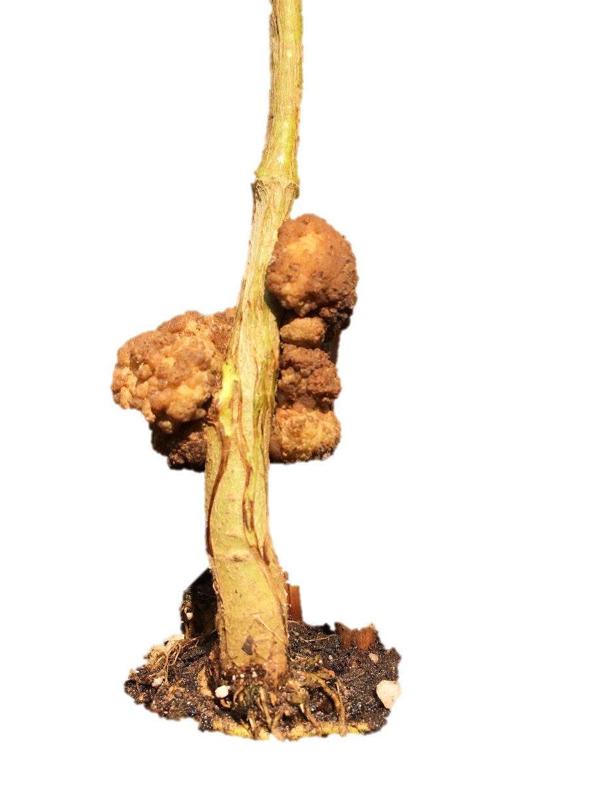
Genomic DNA
Ti Plasmid
tumor-inducing

Slide 3
Genome of Agrobacterium
Genomic DNA
Ti Plasmid
tumor-inducing
Notes:
https://upload.wikimedia.org/wikipedia/commons/thumb/c/cf/Plasmid_(english).svg/2000px-Plasmid_(english).svg.png
HGT

Slide 4
Ti Plasmid tumor-inducing
Left Border
virulence region
moves T-DNA
T-DNA
transfer DNA
Right Border
Notes:
https://upload.wikimedia.org/wikipedia/commons/thumb/c/cf/Plasmid_(english).svg/2000px-Plasmid_(english).svg.png
HGT

Slide 5
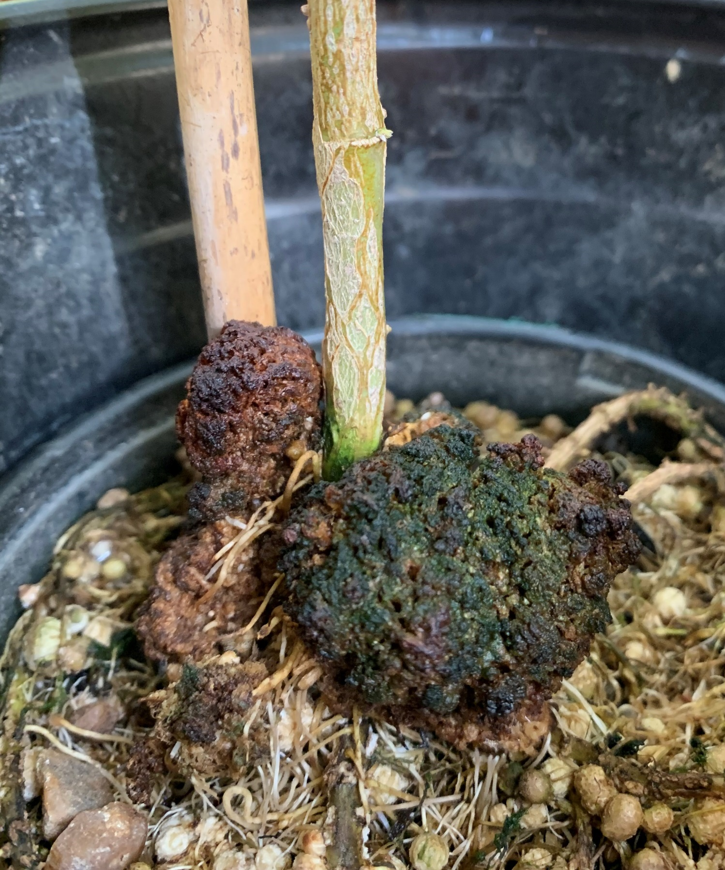
T-DNA contains genes to promote crown galls
Left Border
T-DNA
transfer DNA
Right Border
Crown Gall on Soybean, Photo by Tim Chappell
Notes:
https://upload.wikimedia.org/wikipedia/commons/thumb/c/cf/Plasmid_(english).svg/2000px-Plasmid_(english).svg.png
HGT

Slide 6
The vir (virulence) operons
virulence region
virA – Recognizes plant signals
virB – Forms transfer apparatus (T4SS)
virG – Involved in virulence regulation
virC – T-DNA processing and transfer
virD – T-DNA endonuclease
virE – Protect T-DNA during transfer
Notes:
Explain vir roles a, g, b’s, d’s.
Cut 5 prime and borders
NLS system

Slide 7
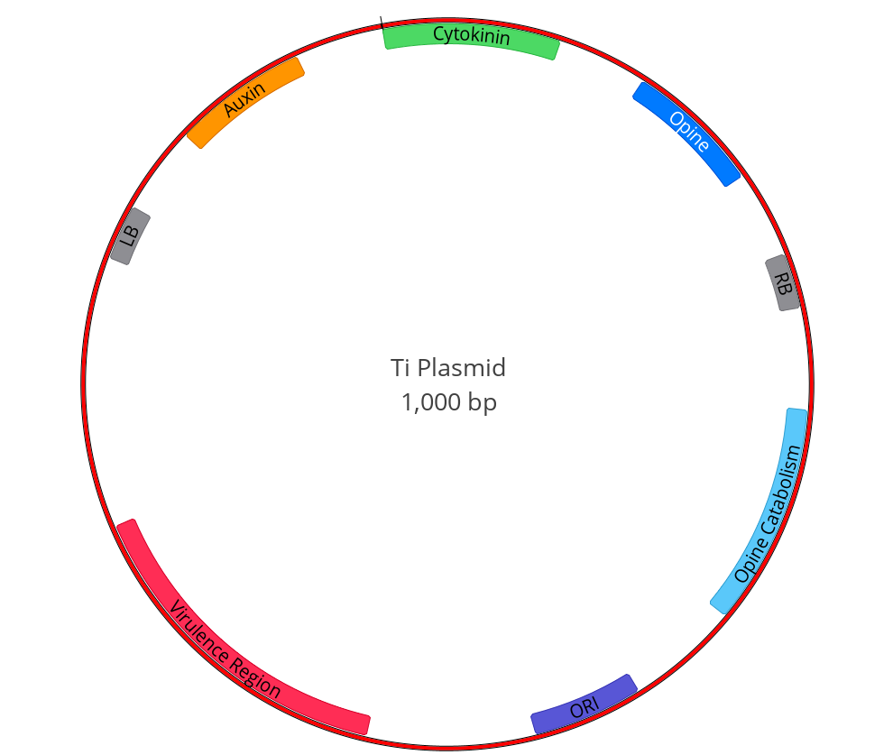
PNG

Slide 8
PNG

Slide 9
EMF – ungroup several times to change

Slide 10

The vir (virulence) regulon
virulence region
vir H
vir A
vir B
vir G
vir C
vir D
vir E
vir F
Notes:
Explain vir roles a, g, b’s, d’s.
Cut 5 prime and borders
NLS system

Slide 11
vir activation
vir H
vir A
vir B
vir G
vir C
vir D
vir E
vir F
P
P
P
P
P
P
vir G
vir G
vir G
vir G
vir G
vir G
Acetosyringone
P
vir A
vir G

Slide 12
Mechanism of activation
P
vir A
vir G
P
vir G
vir H
vir A
vir B
vir G
vir C
vir D
vir E
vir F
Activation started. What are the roles of these other vir proteins?
Notes:
Explain vir roles a, g, b’s, d’s.
Cut 5 prime and borders
NLS system
VirG acts as an activator of transcription for the remaining Vir gene operons.

Slide 13
The role of vir D2
Left border (LB)
Right border (RB)
Transfer DNA (T-DNA)
D2
D2
P
vir G
5 ORF
D1 – D5
vir D
Notes:
Explain vir roles a, g, b’s, d’s.
Cut 5 prime and borders
NLS system
VirG acts as an activator of transcription for the remaining Vir gene operons.

Slide 14
The role of vir D2
Left border (LB)
Right border (RB)
Transfer DNA (T-DNA)
D2
D2
New strand synthesis
By Mouagip
Notes:
Explain vir roles a, g, b’s, d’s.
Cut 5 prime and borders
NLS system
VirG acts as an activator of transcription for the remaining Vir gene operons.

Slide 15
Border considerations
GCC [GTCCTATATAAGTTAACATT -------T-DNA------ ACC] GTCCTATATGGCAACATTA
Left Border
Right Border
Your sequence of interest
GCC [GTCCTATATAAGTTAACATT -------T-DNA------ ACC] GTCCTATATGGCAACATTA
Left Border
Right Border
HygR – Cas9
Where is the plant selectable marker?

Slide 16
The role of vir D2 and vir D4
IM
D4
B11
Transfer DNA (T-DNA)
D2
Transfer DNA (T-DNA)
D2
Notes:
Explain vir roles a, g, b’s, d’s.
Cut 5 prime and borders
NLS system
VirG acts as an activator of transcription for the remaining Vir gene operons.
virD protein carries the translocation signal for T-strand docking with the virD4 coupling protein.
This latter protein has ATPase activity and delivers the T-strand to the mating pair channel, the trans envelop secretion system encode by the virB operon. The binding o the T-dna to virD4 and virB11, which also has atpase acitvity, stimulates their atpase activities. This energy in turn activates virb10 through a structural transtion which opens up the channel to the cell surface.

Slide 17
virD2 finds virD4
IM
D4
B11
Transfer DNA (T-DNA)
D2

Slide 18
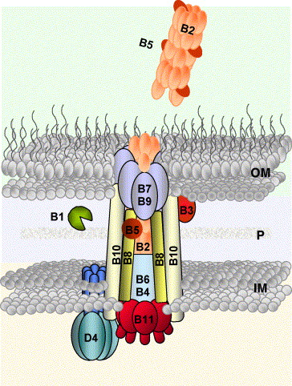
The important role of vir B
P
vir G
B7
B9
OM
B10
B10
B5
B2
B1
vir B
B8
P
B8
11 ORF
B1 – B11
B6
B4
B11
IM
Transfer DNA (T-DNA)
D2
Notes:
Explain vir roles a, g, b’s, d’s.
Cut 5 prime and borders
NLS system
VirG acts as an activator of transcription for the remaining Vir gene operons.
Bacterial cells contact a host-cell receptor using VirB2 pilin and VirB5 adhesin. In the donor, the T4CP VirD4 delivers relaxase-linked single-stranded T-DNA to the IM secretion channel. Other bacterial factors specifically transported include VirE3, VirF, VirD5 and the single-stranded DNA (ssDNA)-binding protein VirE2, which coats and protects the T-DNA. VirD4-like proteins have DNA-dependent ATPase activity, and current models propose that DNA translocase activity ensures processivity during secretion. Two additional ATPases energize the system from the cytoplasm. VirB4 is present in all known Gram-negative T4SSs, whereas VirB11 is a hexameric ATPase not universally found. These ATPases are thought to provide energy for T4SS assembly and active secretion. Seminal work by Cascales & Christie [9] developed a formaldehyde cross-linking assay to identify the sequential translocation steps occurring during substrate secretion, providing the first clearly defined pathway for substrate progression through a T4 secretion apparatus (figure 3a). The VirD4 T4CP receptor binds the substrate first and transfers it to the VirB11 ATPase. The ATP hydrolysing activity of the VirD4, VirB4 and VirB11 trio is coordinated by VirB11 to transfer the substrate to channel proteins VirB6 and VirB8, conveying the substrate across the IM. The substrate then contacts VirB9 and VirB2 within the channel for subsequent translocation across the periplasm and OM. This pathway is likely to be conserved among DNA delivery systems. The question of whether other T4 functional subgroups operate similarly awaits analysis of additional systems at this level of experimental detail.
https://www.google.com/search?q=vir+b+pilus&espv=2&biw=1920&bih=979&source=lnms&tbm=isch&sa=X&ved=0ahUKEwjLpu6bjvbLAhVD6yYKHeUTCdAQ_AUIBygC#imgrc=SzXpnj_1E3GPLM%3A
http://www.ask-force.org/web/Genomics/Nester-Agrobacterium-Natures-Genetic-Engineer-2015.pdf
http://www.ncbi.nlm.nih.gov/pmc/articles/PMC150518/pdf/0003.pdf
http://www.sciencedirect.com/science/article/pii/S0167488904000850

Slide 19
The important role of vir B
Plant Host Cell
P
vir G
B5
B2
B5
vir B
B7
B9
OM
B10
B10
B5
11 ORF
B1 – B12
B1
B2
P
B8
B8
B6
B4
IM
B11
Notes:
Explain vir roles a, g, b’s, d’s.
Cut 5 prime and borders
NLS system
VirG acts as an activator of transcription for the remaining Vir gene operons.
Bacterial cells contact a host-cell receptor using VirB2 pilin and VirB5 adhesin. In the donor, the T4CP VirD4 delivers relaxase-linked single-stranded T-DNA to the IM secretion channel. Other bacterial factors specifically transported include VirE3, VirF, VirD5 and the single-stranded DNA (ssDNA)-binding protein VirE2, which coats and protects the T-DNA. VirD4-like proteins have DNA-dependent ATPase activity, and current models propose that DNA translocase activity ensures processivity during secretion. Two additional ATPases energize the system from the cytoplasm. VirB4 is present in all known Gram-negative T4SSs, whereas VirB11 is a hexameric ATPase not universally found. These ATPases are thought to provide energy for T4SS assembly and active secretion. Seminal work by Cascales & Christie [9] developed a formaldehyde cross-linking assay to identify the sequential translocation steps occurring during substrate secretion, providing the first clearly defined pathway for substrate progression through a T4 secretion apparatus (figure 3a). The VirD4 T4CP receptor binds the substrate first and transfers it to the VirB11 ATPase. The ATP hydrolysing activity of the VirD4, VirB4 and VirB11 trio is coordinated by VirB11 to transfer the substrate to channel proteins VirB6 and VirB8, conveying the substrate across the IM. The substrate then contacts VirB9 and VirB2 within the channel for subsequent translocation across the periplasm and OM. This pathway is likely to be conserved among DNA delivery systems. The question of whether other T4 functional subgroups operate similarly awaits analysis of additional systems at this level of experimental detail.
https://www.google.com/search?q=vir+b+pilus&espv=2&biw=1920&bih=979&source=lnms&tbm=isch&sa=X&ved=0ahUKEwjLpu6bjvbLAhVD6yYKHeUTCdAQ_AUIBygC#imgrc=SzXpnj_1E3GPLM%3A
http://www.ask-force.org/web/Genomics/Nester-Agrobacterium-Natures-Genetic-Engineer-2015.pdf
http://www.ncbi.nlm.nih.gov/pmc/articles/PMC150518/pdf/0003.pdf
http://www.sciencedirect.com/science/article/pii/S0167488904000850

Slide 20
The role of vir E2 and T-DNA
E2
E2
E2
E2
E2
E2
E2
E2
Transfer DNA (T-DNA)
D2
B7
B9
B10
B10
E2
E2
E2
E2
E2
E2
E2
E2
B5
B1
B2
B2
B5
B8
B8
B6
B4
B5
B11
Plant cytoplasm
Notes:
Explain vir roles a, g, b’s, d’s.
Cut 5 prime and borders
NLS system
VirG acts as an activator of transcription for the remaining Vir gene operons.

Slide 21
Into the nucleus
Plant nucleus
E2
E2
E2
E2
E2
E2
E2
E2
Transfer DNA (T-DNA)
D2
E2
E2
E2
E2
E2
E2
E2
E2
T-DNA

Slide 22
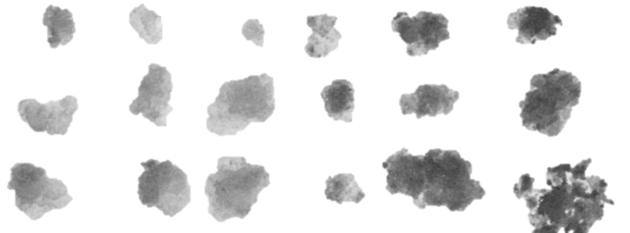
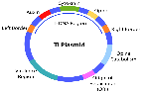

The transfer DNA (T-DNA) region
Cytokinin
Left border
Auxin
Auxin
Cytokinin
Opine
Right border
vir operon
https://upload.wikimedia.org/wikipedia/commons/thumb/c/cf/Plasmid_(english).svg/2000px-Plasmid_(english).svg.png
Notes:
Are hormones development
Explain repeat borders
Hormones for plant transfer
Opine to feed its own catabolism
Virulence region
Transfer DNA – T-DNA
Original BBM/WUS

Slide 23
Disarming Ti Plasmid remove native T-DNA
Introduce a binary vector
Containing T-DNA of interest
Left Border
T-DNA
transfer DNA
Rely on native Ti plasmid virulence genes to transfer new T-DNA
Right Border
Notes:
https://upload.wikimedia.org/wikipedia/commons/thumb/c/cf/Plasmid_(english).svg/2000px-Plasmid_(english).svg.png
HGT

Slide 24
Binary System
Genomic DNA
Ti Plasmid
Binary Plasmid
Notes:
https://upload.wikimedia.org/wikipedia/commons/thumb/c/cf/Plasmid_(english).svg/2000px-Plasmid_(english).svg.png
HGT

Slide 25
Ternary System
Ti Plasmid
no T-DNA
Binary Plasmid
With T-DNA
Ternary Plasmid
Extra virulence genes
Genomic DNA
Notes:
https://upload.wikimedia.org/wikipedia/commons/thumb/c/cf/Plasmid_(english).svg/2000px-Plasmid_(english).svg.png
HGT

Slide 26
Binary/Ternary plasmids
Super
Binary plasmid
Disarmed Ti plasmid
Binary plasmid
Ternary plasmid
Disarmed Agrobacterium
Genes of interest
Binary system
Binary plasmid
(Genes of interest + virulence genes)
Super Binary System
Genes of interest
Ternary plasmid
(virulence genes)
Ternary System
Additional virulence genes to aid in DNA transfer

Slide 27
New Agrobacterium strain
Agrobacterium EF-Tu
Bradyrhizobium EF-Tu
rplC
rpsJ
EF-Tu a
fusA
Forward Flank
Reverse Flank
~1000bp
~1000bp
Bradyrhizobium EF-Tu
~1200bp

Slide 28
Bacterial recombination
Conjugate pDONR into Agrobacterium using RHO5 (requires DAP) OR electroporate pDONR
RHO5
Agrobacterium
LB + DAP plate
RHO5 + Agrobacterium
sacB
KmR
mob
pDONRK18mobsacB
A
EF-Tu
B

Slide 29
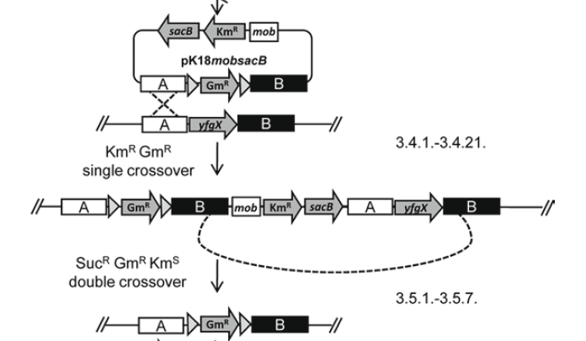
Single crossover
sacB
KmR
mob
pDONRK18mobsacB
A
EF-Tu
B
Conjugation in Atu
A
EF-Tu
B
A
EF-Tu
mob
KmR
sacB
A
EF-Tu
B
B
Kanamycin resistant
Sucrose sensitive

Slide 30
Merodiploid – after single crossover
A
EF-Tu
mob
KmR
sacB
A
EF-Tu
B
B
Kanamycin resistant
LB + Kan plate
LB + Sucrose plate
Sucrose sensitive
Agrobacterium only
Desired Agrobacterium only

Slide 31
Forcing second crossover
A
EF-Tu
mob
KmR
sacB
A
EF-Tu
B
B
Sucrose sensitive
LB + Sucrose plate
Desired Agrobacterium only
EF-Tu
EF-Tu
A
B
A
B

Slide 32
Electroporation with A. tumefaciens
Flank A
Atu EF-Tu
Flank B
Bja EF-Tu
Flank A
Flank B
pDONRBjaEF-Tu
9226 bp

Slide 33
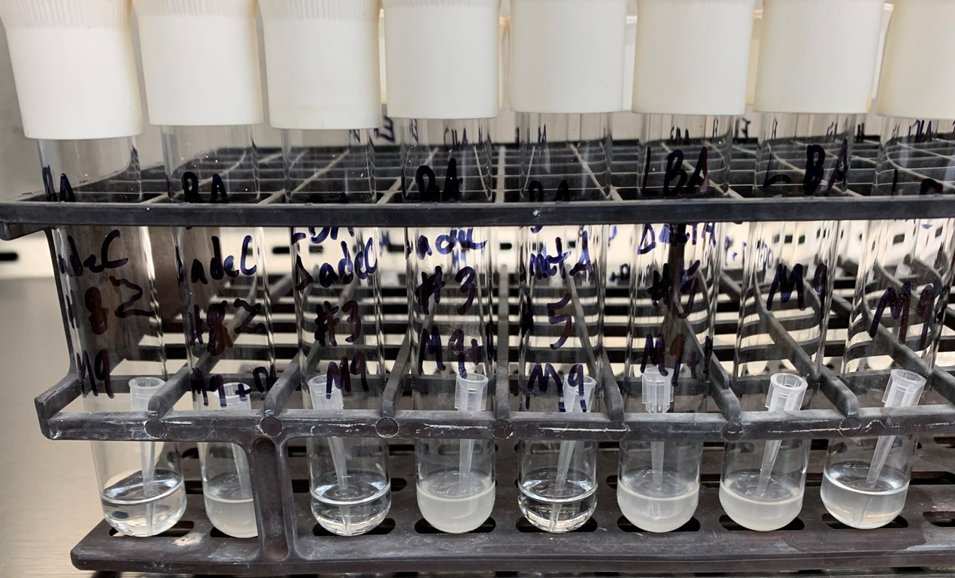
Agrobacterium auxotroph example
M9
M9 + DO
M9
M9 + DO
M9
M9 + DO
M9
M9 + DO
adeC #2
adenine
adeC #3
adenine
metA #5
methionine
Control LBA4404
Notes:
Dropout is common in yeast work, contains amino acids compared to minimal M9 medium.

Slide 34
The effector proteins
Known effector proteins
virE2, virE3, virD5, virF, virD2
virE2
coats ssDNA, translocated, NLS
virE3
binds TFs, activates VBF in Arabidopsis, helps virE2 & VIP1
virF (similar to virE3)
present in octopine strains (not nopaline)
virD5
NLS, can be toxic by generating chromosome loss / ploidy effects, interacts VIP2, thought to be histone-related
These proteins are unique candidates for helping protein and/or DNA delivery

Slide 35

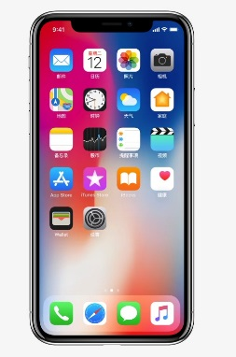


Taxonomy
L-arabitol for biovar 1 – Tumor-inducing
Erythritol for biovar 2 – Root-inducing
Tartrate and D-glutamate for biovar 3 – A. rubris
Certain groups within the Rhizobium have gained or loss certain functions:
Polygalacturonide utilization
Ferulic acid catabolism, opine metabolism, curdlan, LPS O-antigen
Within nodule and Agrobacterium subgroups, many changes to the LPS O-antigen
Brisbane & Kerr, 1983

Slide 36
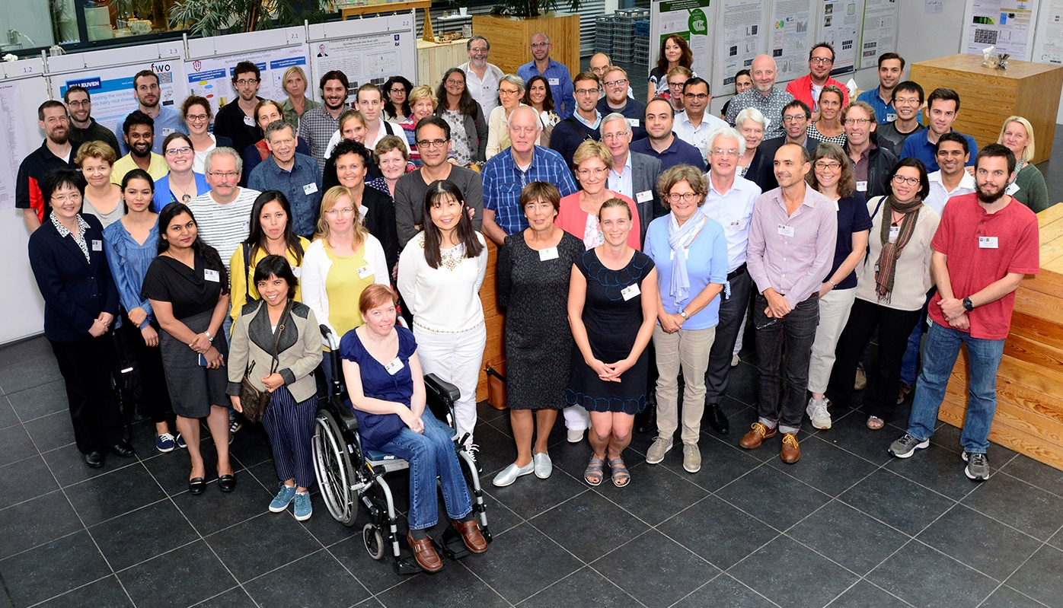
39th Crown Gall Attendees

Slide 37
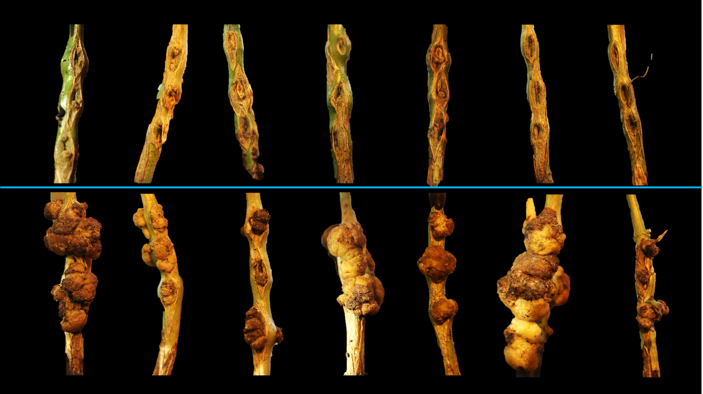
Differences in susceptibility between soybean genotypes
Resistant
Susceptible

Slide 38
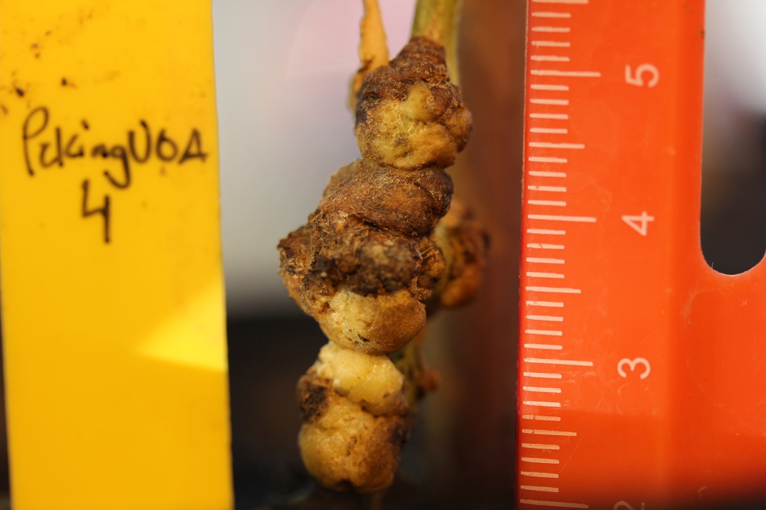
P 4 – susceptible genotype

Slide 39
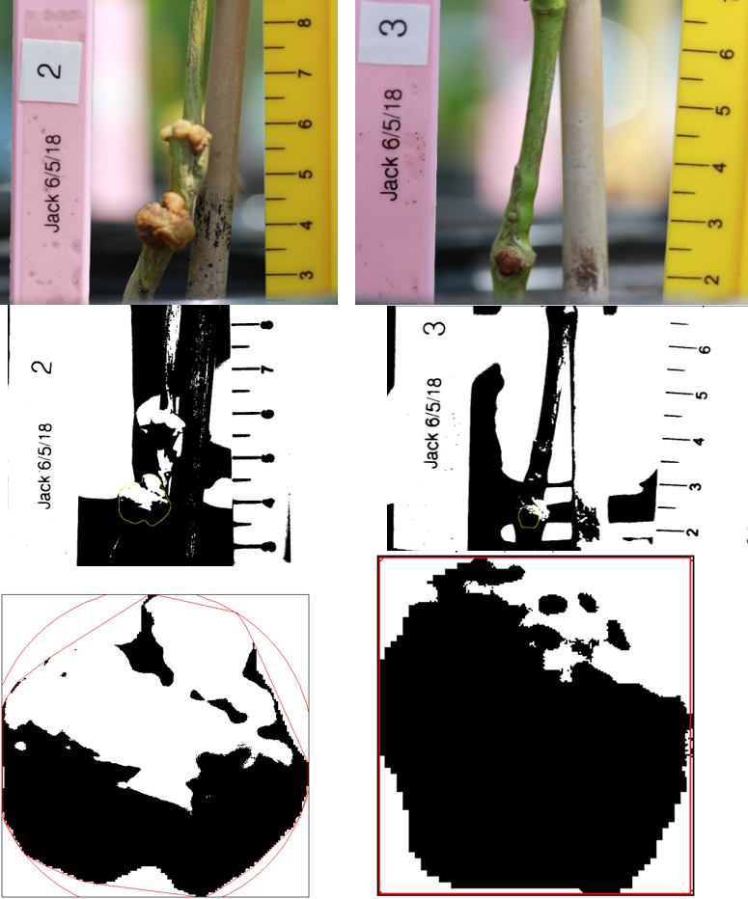
Phenotyping
Original
Calibration and gall selection
Computation of measurements
Notes:
ImageJ analysis, also possible to do 3D modeling, use opencv/tensorflow.

Slide 40
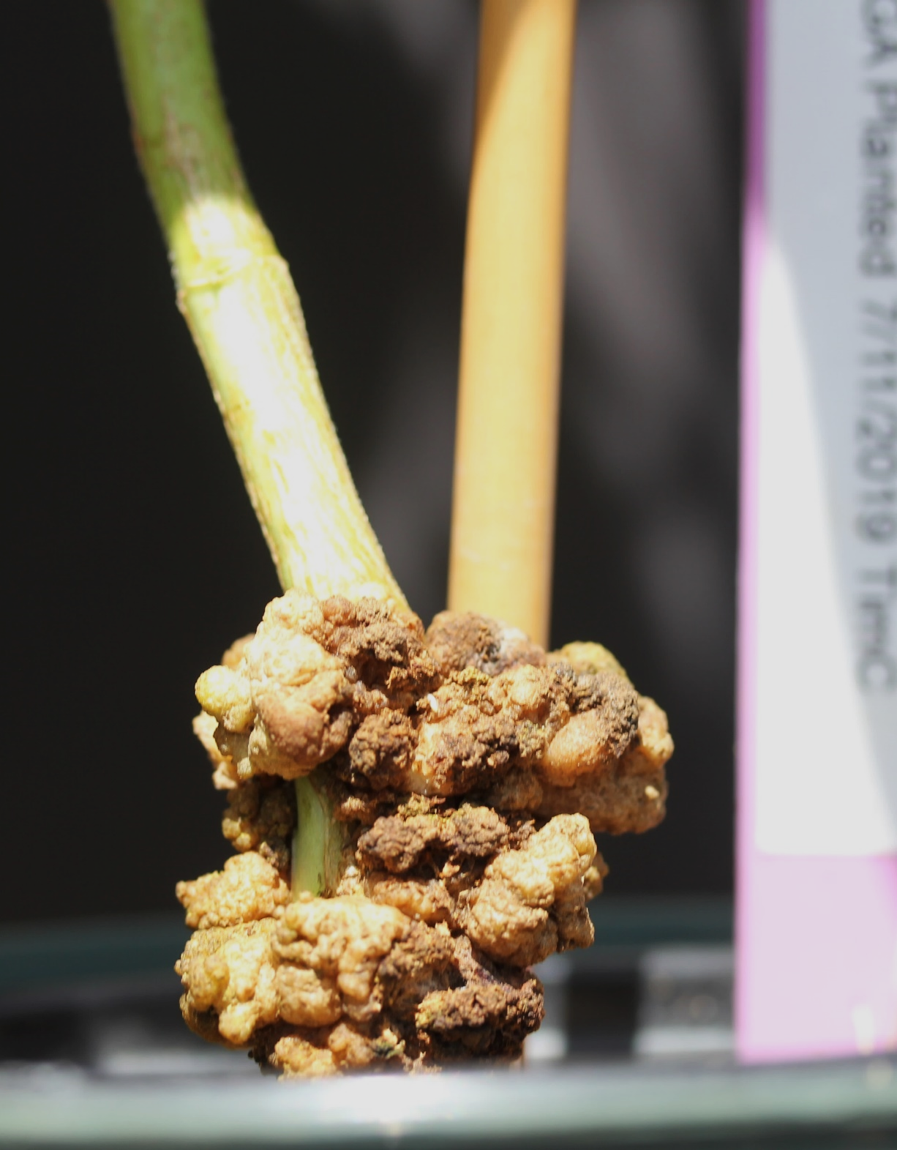
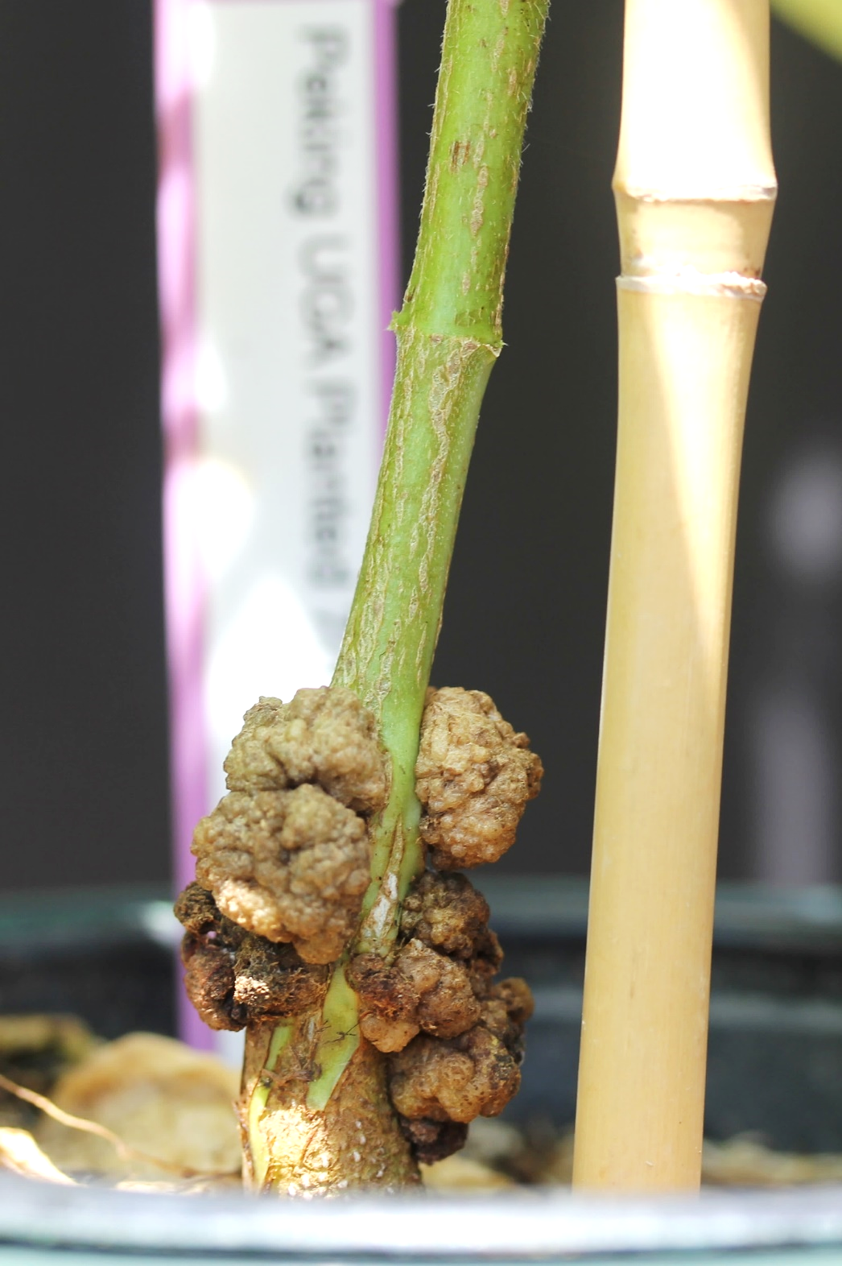
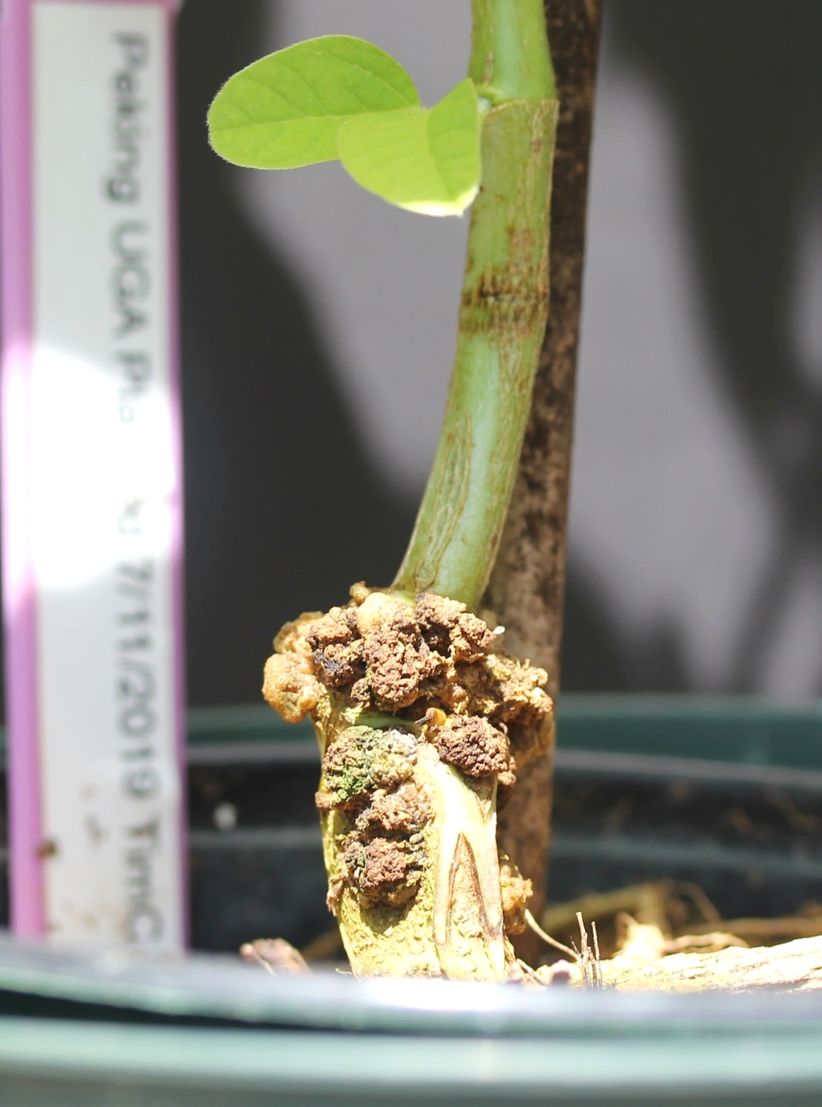
Galls on susceptible

Slide 41
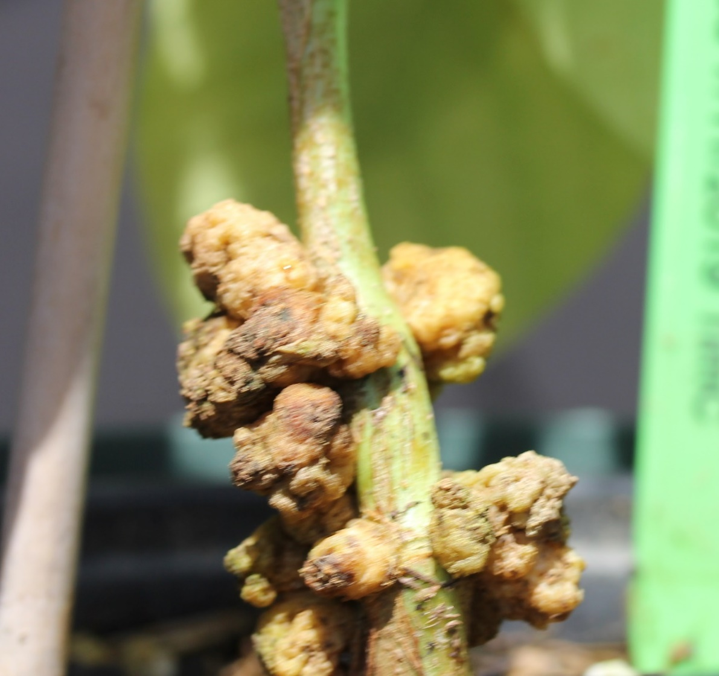
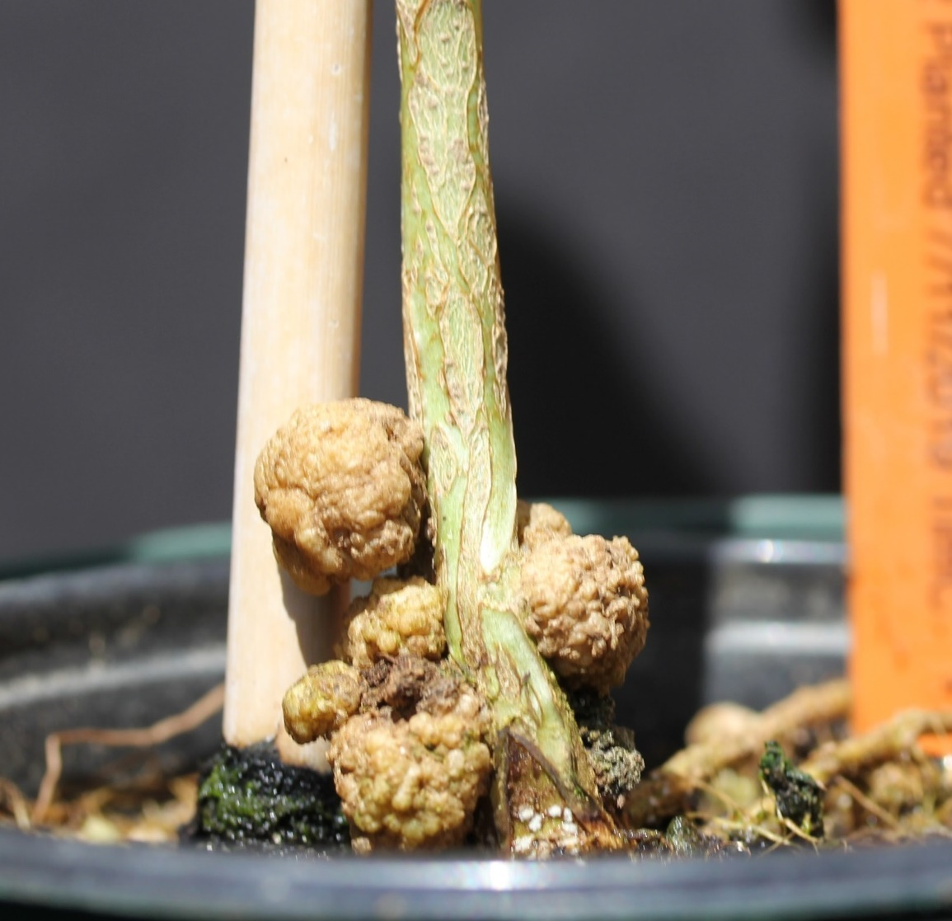
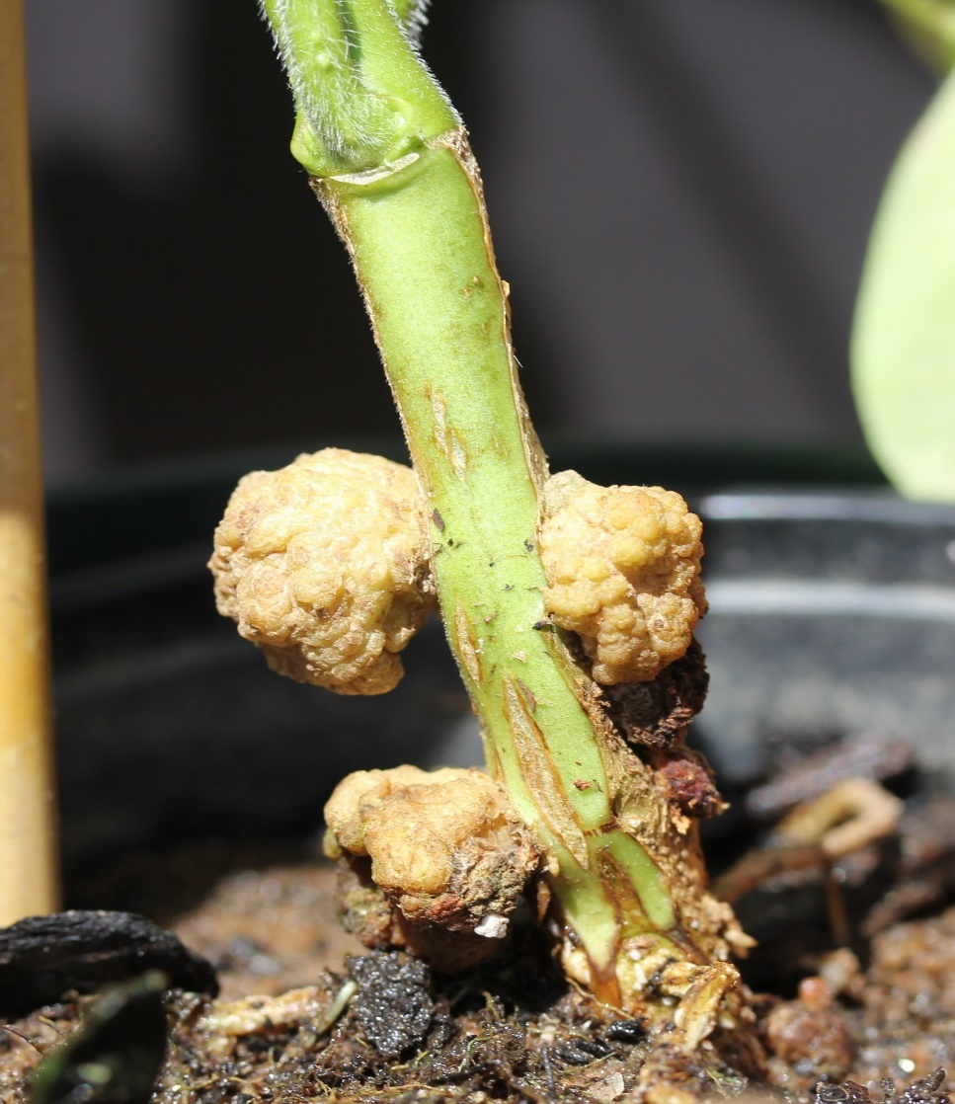
Some RIL examples from susceptible x resistant

Slide 42
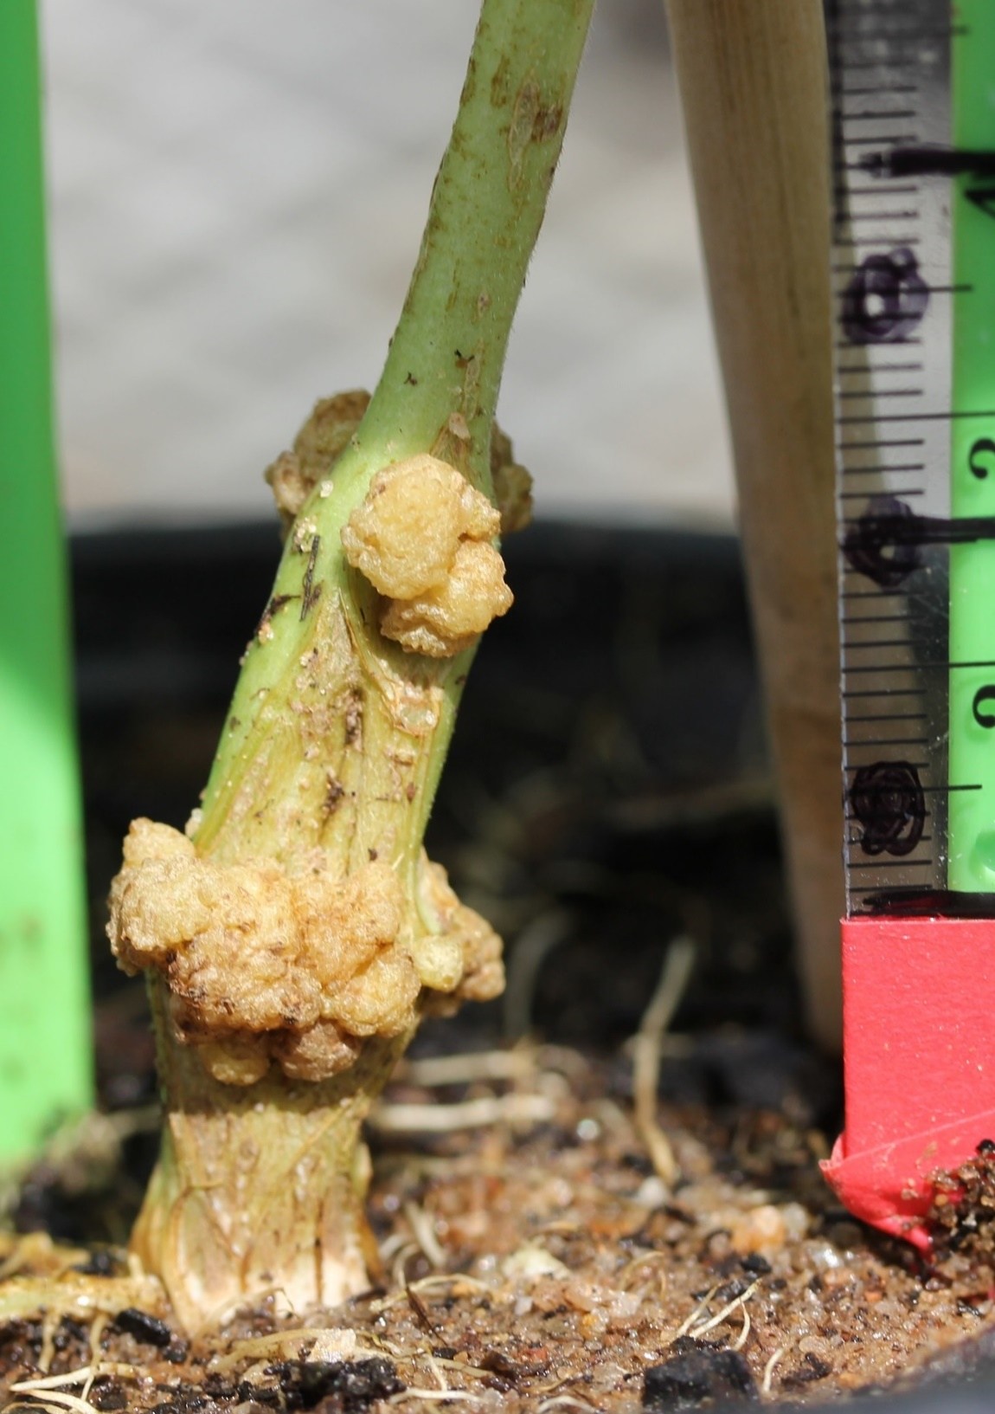
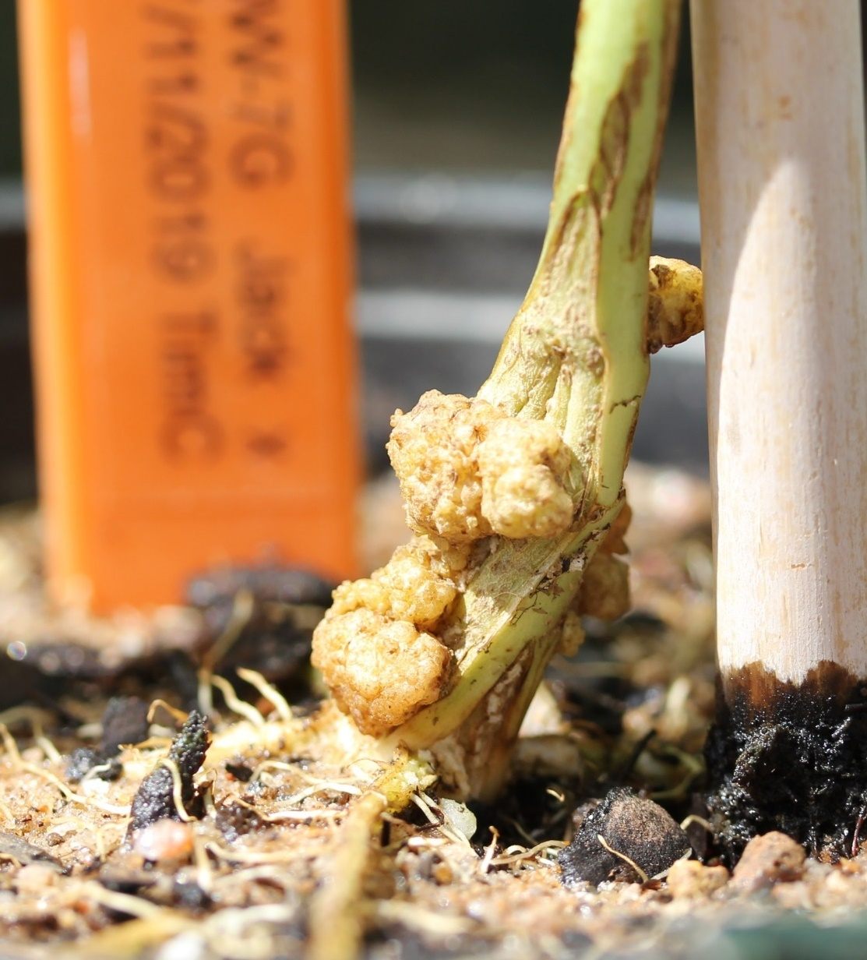
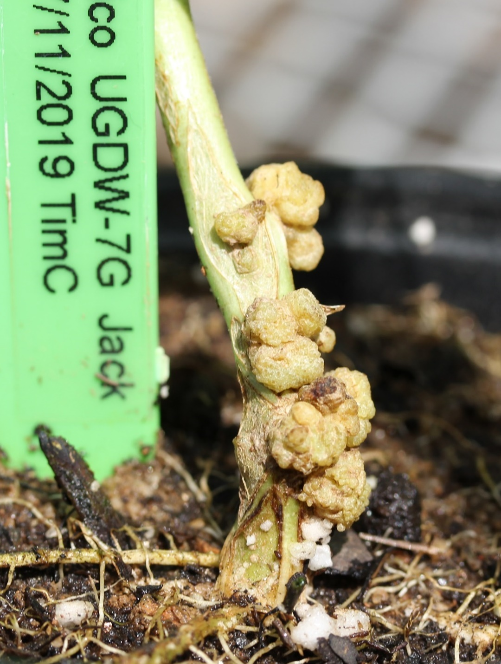
More galling RILs

Slide 43
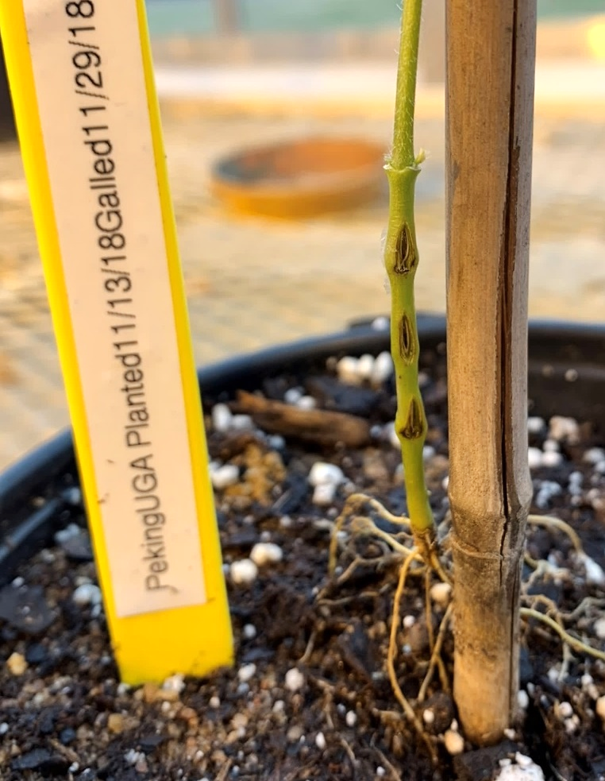
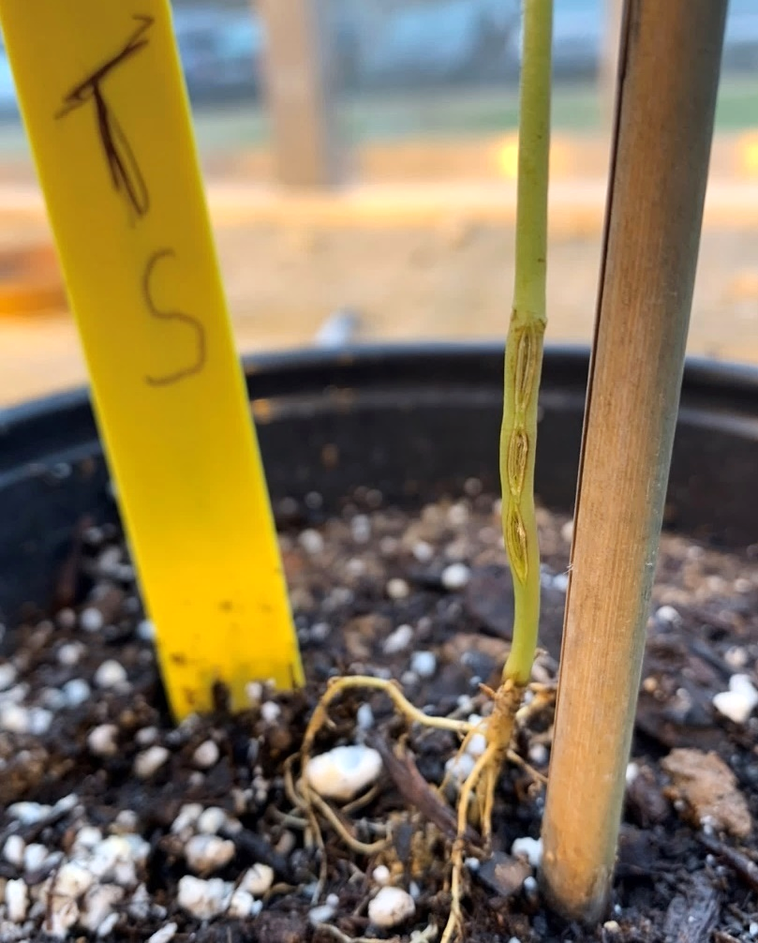
Soybean – left stabbed with Agro, right with no Agro
Stabbed with Agro
Stabbed without Agro

Slide 44
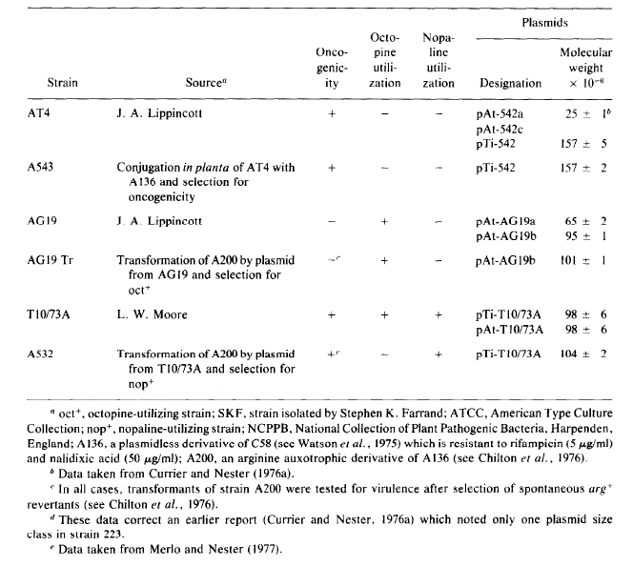
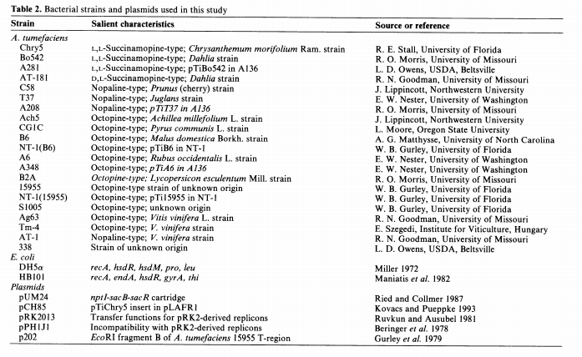
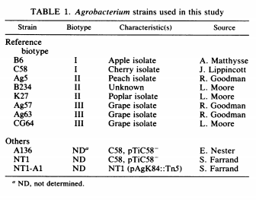

Slide 45
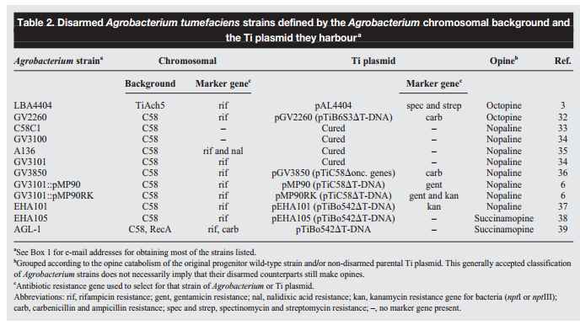
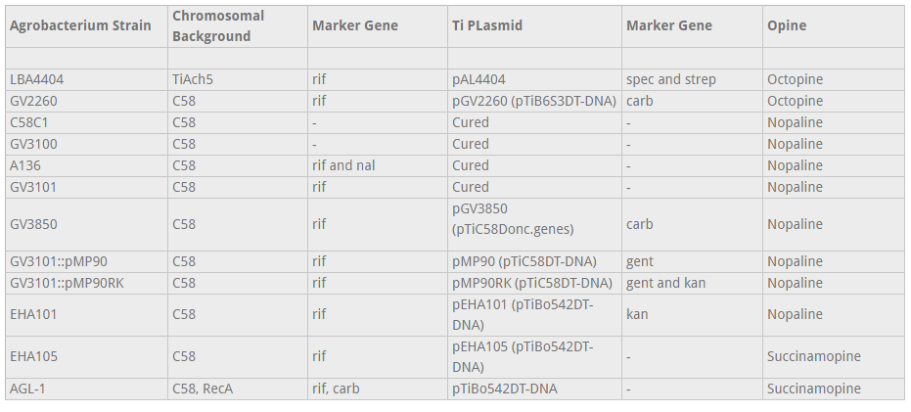
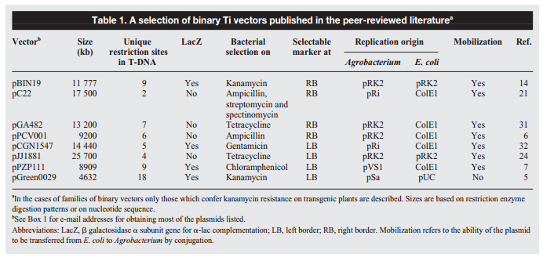

Slide 46
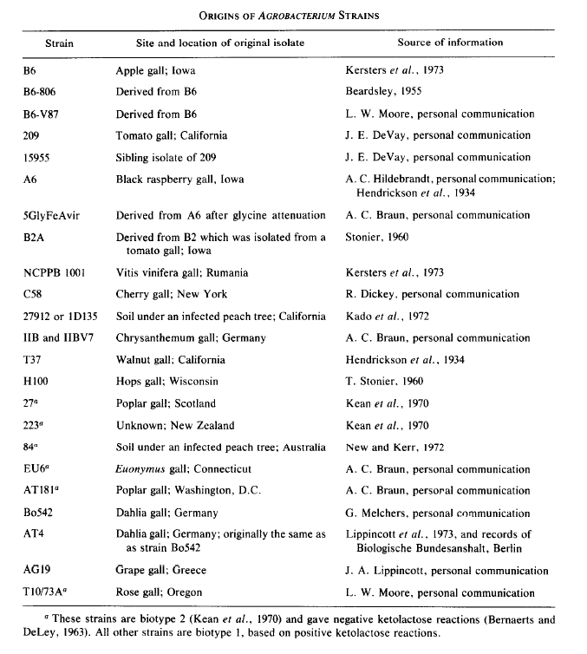
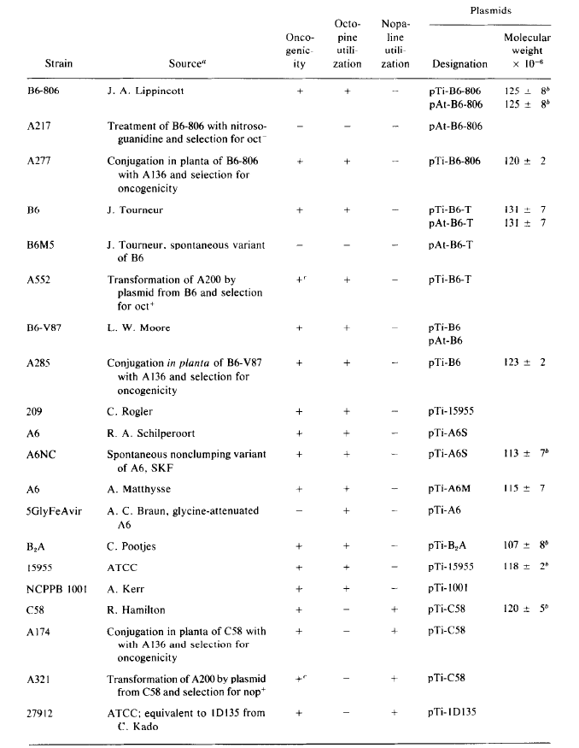
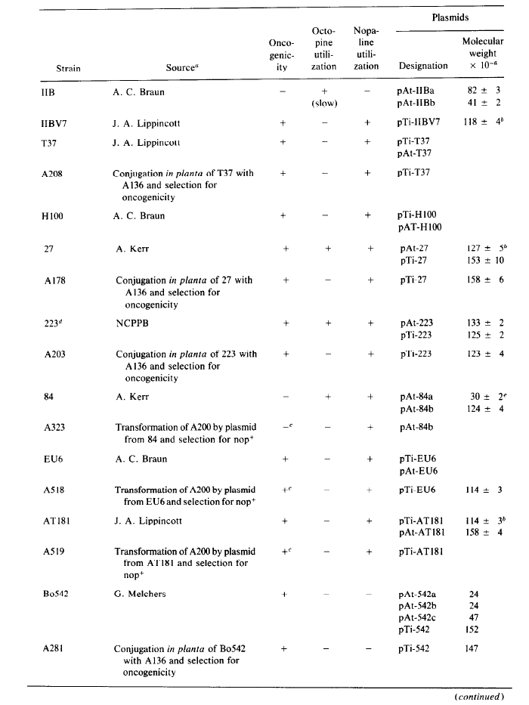

Slide 47
